Slide 1
Customer
Churn
Noor Taqi
DSB3

Slide 2
Agenda
  Problem Statement
  Aim
  Objectives
  Analysis
  Recommendation

Slide 3
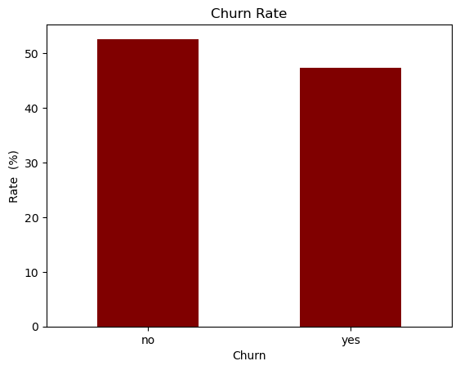
Problem statement
The company is facing a severe customer churn crisis, with 47.4% of 64,374 subscribers canceling their service, resulting in an estimated $18,991,722 in lost revenue and substantially higher customer acquisition costs.

Slide 4
Aim
Identify the key drivers of customer churn and provide data-driven strategies to improve customer retention and protect recurring revenue.

Slide 5
1
What is the churn rate across age categories and gender, and which age-gender segment has the highest churn rate?
How does the churn rate vary by contract length (Monthly, Quarterly, Annual) and subscription type (Basic, Standard, Premium), and which factor differentiates churn more?
2
Objectives
3
Which tenure months (1-60) have the highest and lowest churn rates, and does low tenure imply a high churn rate?
4
What percentage of customers had a payment delay exceeding 14 days across all customers, and how does the churn rate differ between high-delay and low-delay customers?
5
How does the churn rate vary with the number of support calls (0-10), and how does it differ between customers with more than 6 calls and those with 6 or fewer?

Slide 6
Analysis

Slide 7
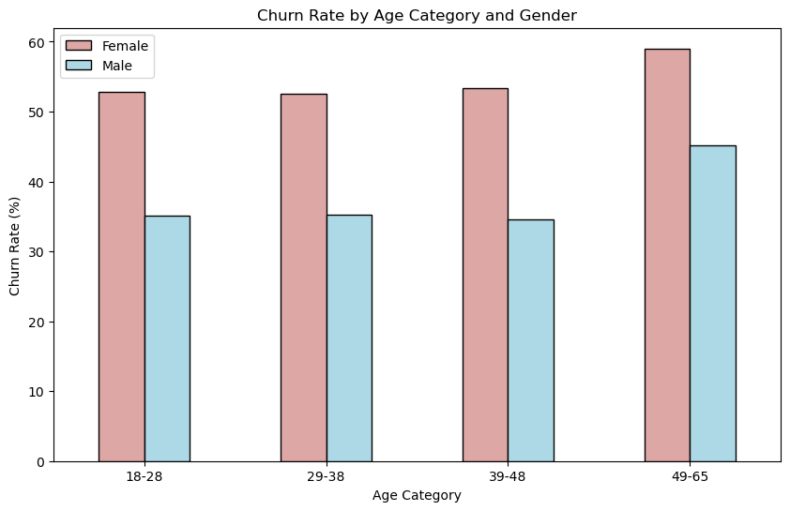
Churn by Age &Gender
Female subscribers exhibit a consistently higher churn rate than male subscribers across all age groups. While churn peaks in the 49–65 age category for both genders.

Slide 8
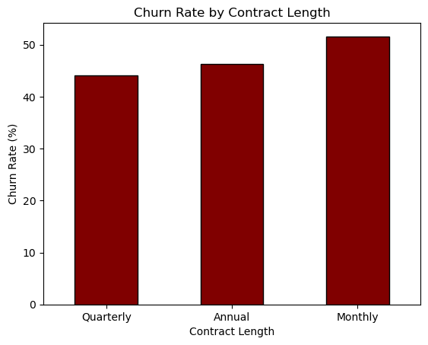
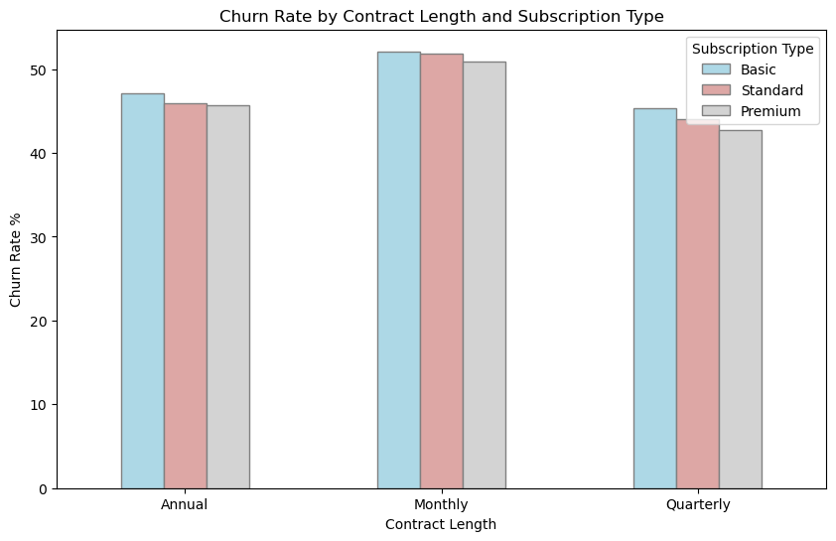
Contract Length Impact
Monthly subscribers record the highest churn rate at over 50%, This confirms that short-term contracts are a main driver of customer loss.

Slide 9
Contract Length Impact
Subscription type has negligible impact on churn, with the Basic plan recording only slightly higher rates .

Slide 10
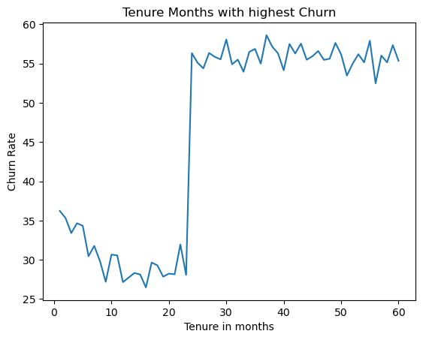
Customer’s Tenure
  Customer tenure splits into two distinct groups, jumping from lowest churn under 22 months to highest after.
  Higher tenure directly correlates with a higher churn rate.

Slide 11
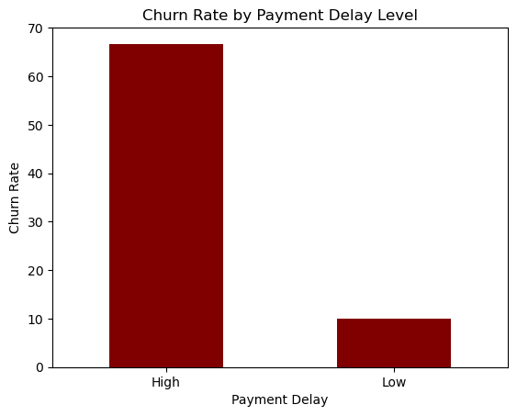
Churn Risk by Payment Delay
Customers with high payment delays are nearly five times more likely to churn than those with low delays.

Slide 12
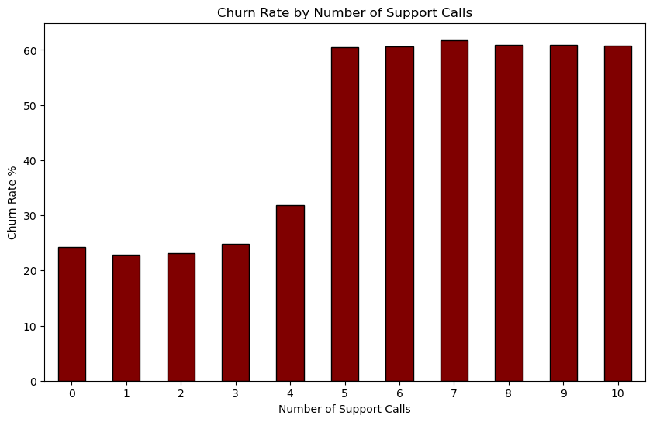
Support calls
Threshold
  Churn rate spikes sharply to over 60% after 4 support calls.
  Frequent calls may indicate service issues, leading to customer churn.

Slide 13
Recommendation
Monitor customers who make frequent support calls and follow up on existing issues.
Offer flexible payment options and reminders to customers who are more likely to be late with payments.
Offer tiered upgrades based on tenure, giving long-standing customers added value that discourages them from cancelling their subscription.
Encourage customers to switch to longer-term contracts, such as annual ones.

Slide 14
THANK YOU

